Slide 1

Global Trade Analysis
Submitted By:-
Anjali Dembla
Namrata Rath
Shreyash Mehta

Slide 2

What is Global Trade?
Global trade is the exchange of goods and services among nations.
Imports are goods and services purchased from other countries.
Exports are goods and services sold to other countries.
The global marketplace exists because countries need to trade with one another.
The new global marketplace makes all people and businesses in the world both potential customers and potential employees or employers.
.

Slide 3

Benefits Of Global Trade
Consumers, producers, workers, and nations benefit from international trade in different ways.
Consumers benefit from the competition that the foreign companies offer. This competition encourages the production of high quality goods with lower prices. The variety of goods increases as more producers market their goods in other countries. Individuals have more options when making purchasing decisions
Many Producers expand business by conducting operations in other countries. About 1/3 of the profits of US businesses come from international trade and foreign investment
Workers also benefit from international trade. Increased trade can lead to higher employment rates both at home and abroad. For example, according to the US Chamber of Commerce, Toyota, a Japanese company, has generated 500,000 jobs in the United States.
Nations as a whole benefit from international trade. Increased foreign investment in a country often improves the standard of living for that country’s people

Slide 4

Contents
Problem statement
Data description
Data preparation
Visuals screenshots
Insights derived

Slide 5
Problem Statement
Import and Export data available for 12 major categories and the commodities under them along with the year (from 1988 to 2016). Trade amount (USD) & quantity.
Looking for insights around potential commodities, trade amount, year, the quantity of that commodity, and countries.
Clean up the data for missing values, required computed fields and incorrect values.
The visualizations should be innovative and interactive dashboards/story which allows the audience to better understand.

Slide 6
Data Description
Source of Data:-
Dataset obtained from Kaggle
Number Of Rows:-
The original dataset contains 10 columns and 8,225,871 rows, but we have sampled the data for 7 specific countries i.e., India, USA, UK, Canada, South Africa, Argentina, and Australia which counts to a total of 87570 rows.
Columns Names:-
Country, Year, comm_code, Commodity, Flow, Trade_Usd, Weight(kg), Quantity, Category, Quantity_name

Slide 7
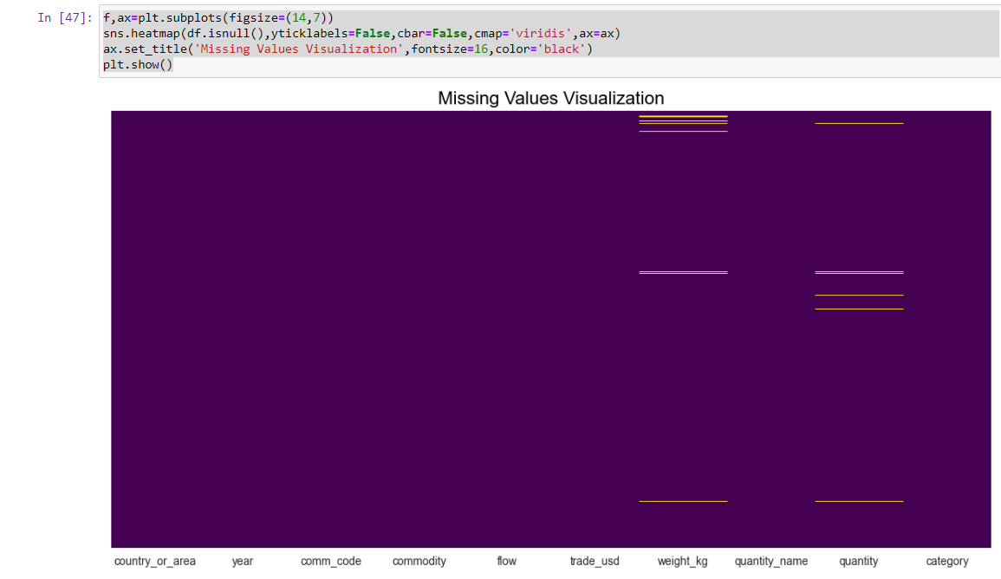
Data Preparation
The data was cleaned using Python programming language and variable names were edited for better reading.
Excel skills were used to add new calculated fields.
Unit Price is calculated using the Trade value and quantity columns.
Unit price= Trade/quantity
The Yellow horizontal lines means
there are some missing values in
those columns.

Slide 8
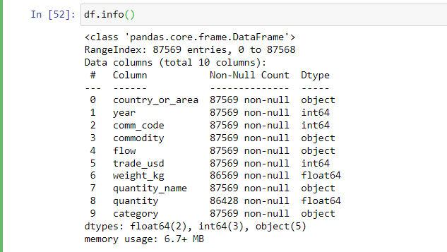
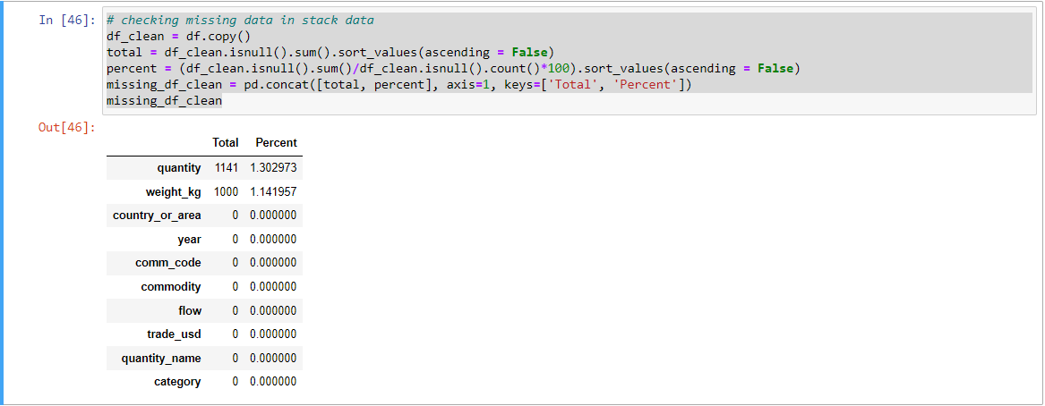
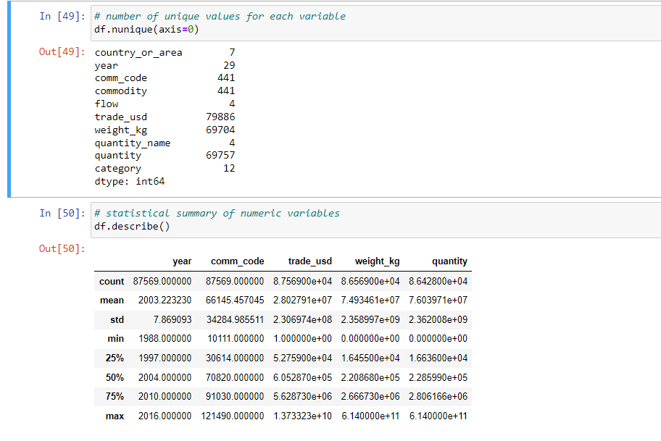
Understanding Data

Slide 9

Visualizations

Slide 10
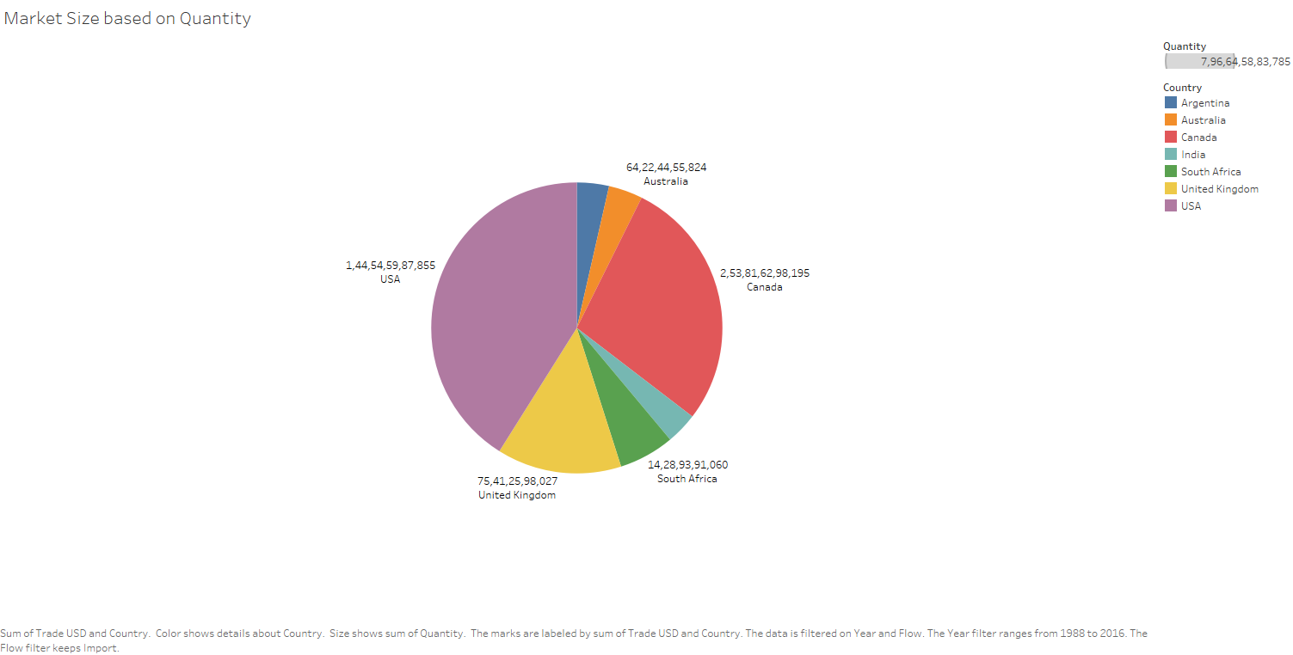
Comparison of Different Countries Based on Market Size on the basis of
Quantity
The above graph depicts the market size share for different countries.
The data can be filtered for the year and the flow(export/import)
USA has the largest market size based on the quantity

Slide 11
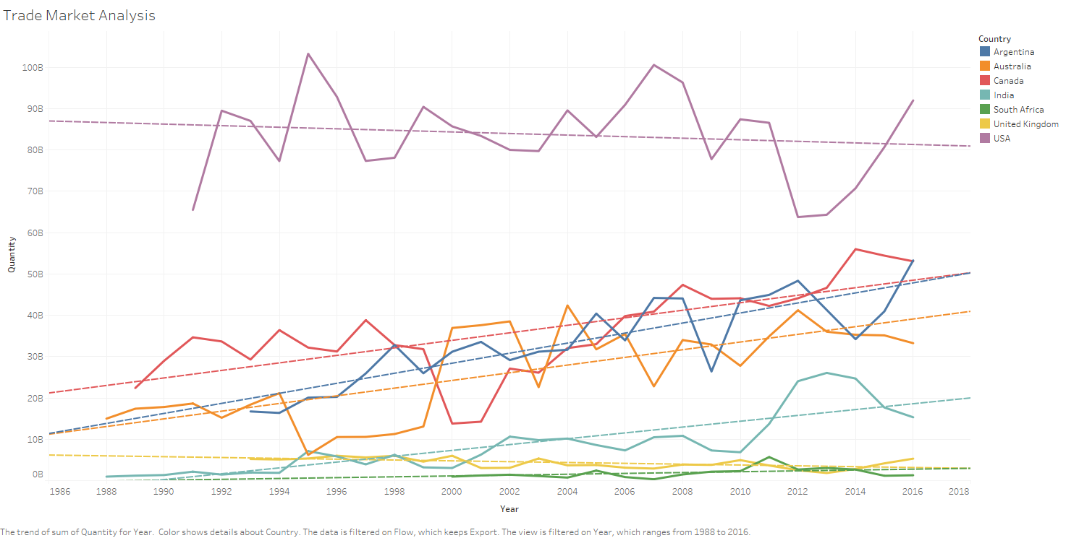
Trade Market Analysis Over The Years
The above graph shows export quantities for different countries.
The lines represent the trend over the years.
As per the chart, South Africa shows consistent quantities over the years, 2000 to 2016. On the other hand, USA shows varying trend in the year range of 1991 to 2016. The quantity is over 65B in the year 1991 and over 91B in the year 2016.

Slide 12
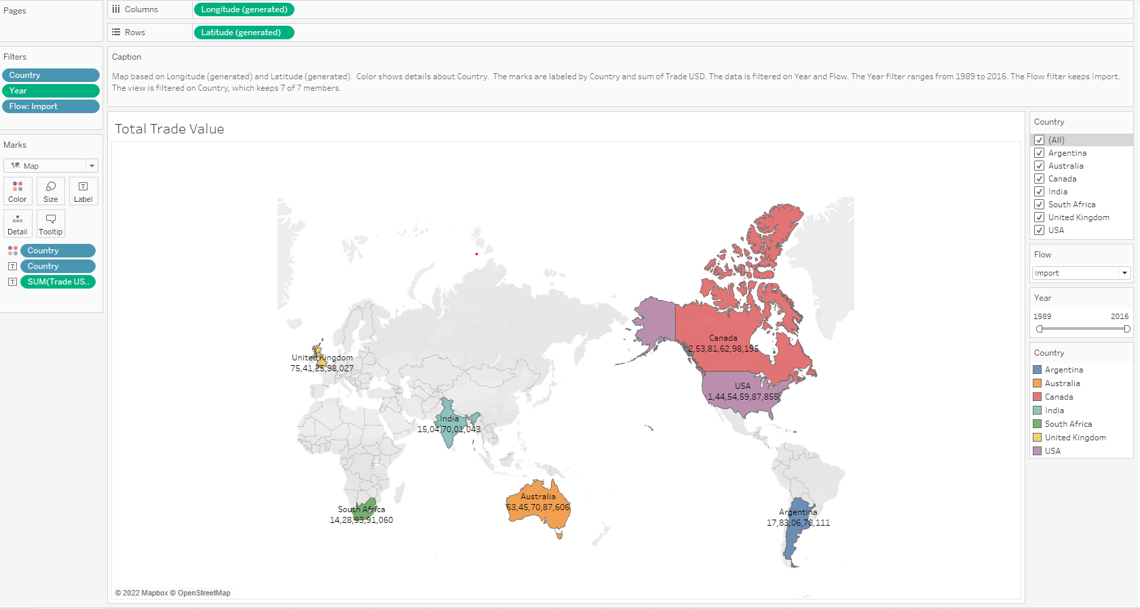
Total Trade Value Depicted On Map
The above chart shows the Trade USD value for different countries.
It can be filtered based on the flow and the year.

Slide 13
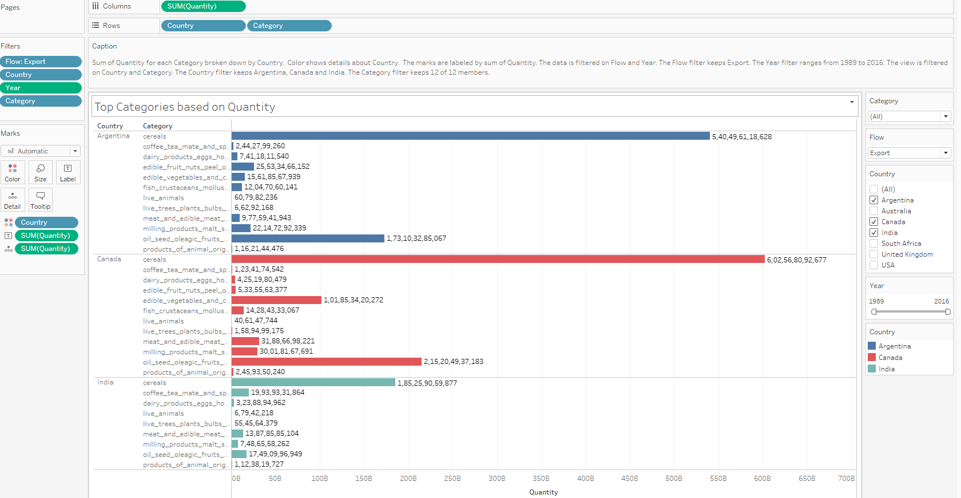
Analyzing quantity distribution of different categories with respect to every country
The above horizontal bar chart shows the quantity distribution of different categories for different countries.
Filters can be applied based on the year, flow and category.

Slide 14
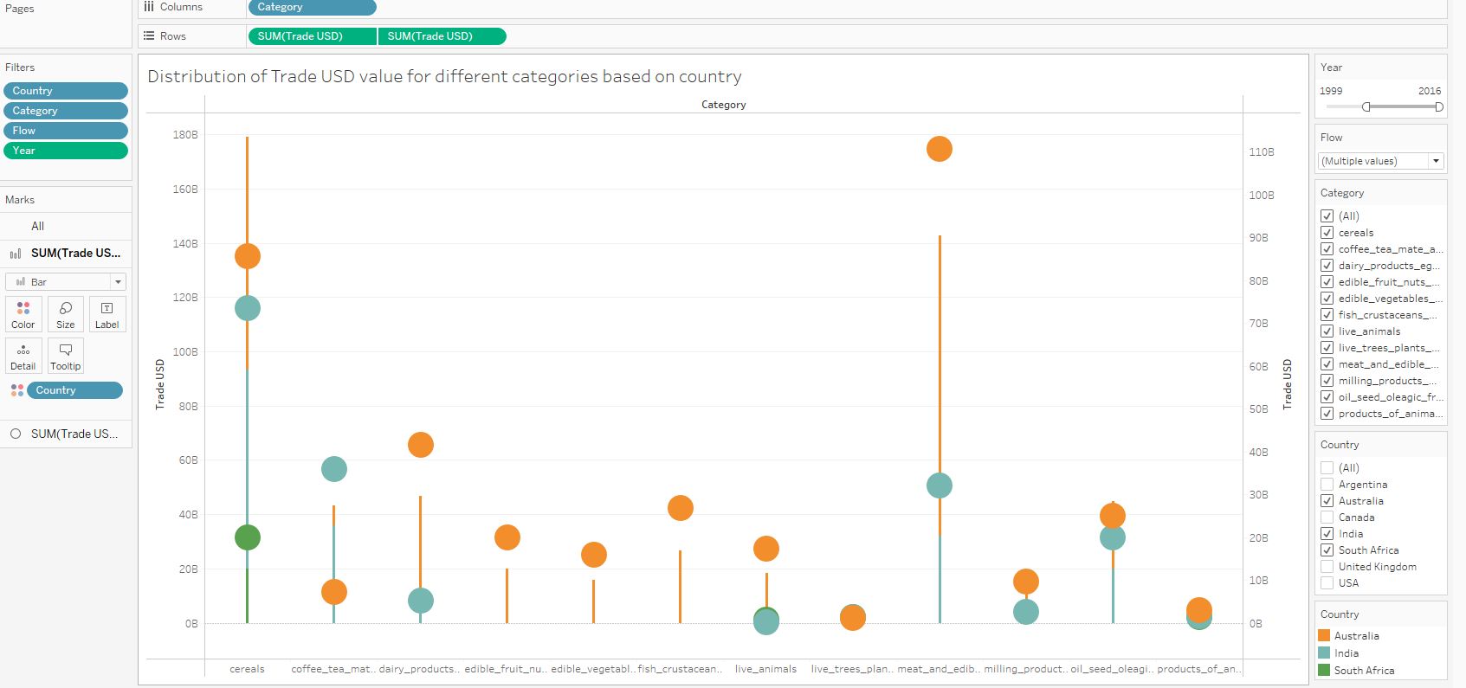
Distribution Of Trade Value Of Various categories For Different Countries
The above chart shows the distribution of trade value of different categories based on different countries.
Filters can be applied for category, flow and country.

Slide 15
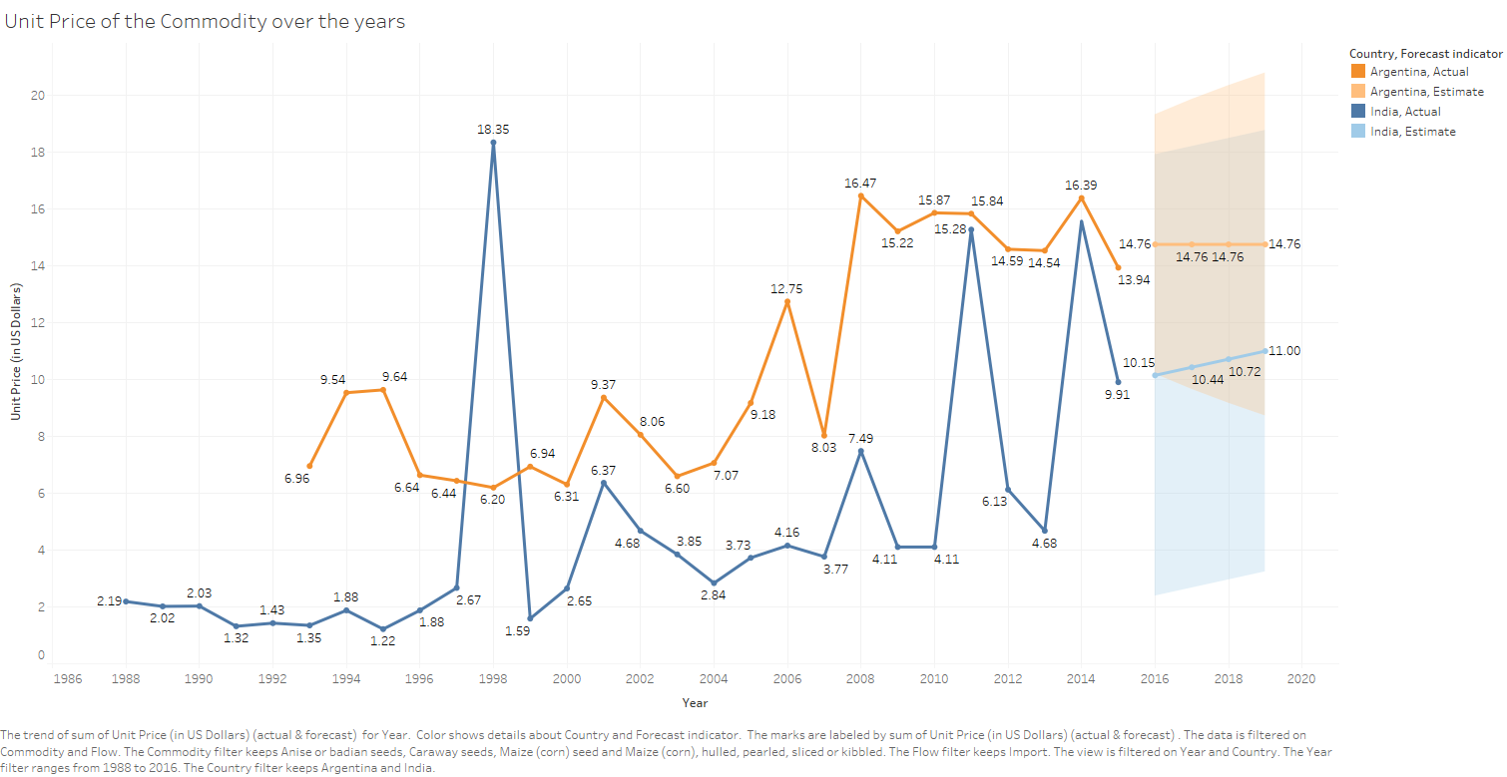
Unit Price Of Commodity Over The Years
The above line chart shows the forecast for the Unit Prices of Argentina and India for the next 5 years.
The data can be filtered on the basis of country, commodity, and flow.
Also the graph above shows the unit price of commodities, Maize corn seed, Caraway seeds, Anise/badian seeds. This can be filtered too. As per the chart, the Unit Price is forecasted to be constant with the value, $14.46 for the next 5 years for Argentina. For India, the Unit price is estimated to be $10.15 in 2016, $10.44 in 2017, $10.72 in 2018 and $11 in 2019.

Slide 16
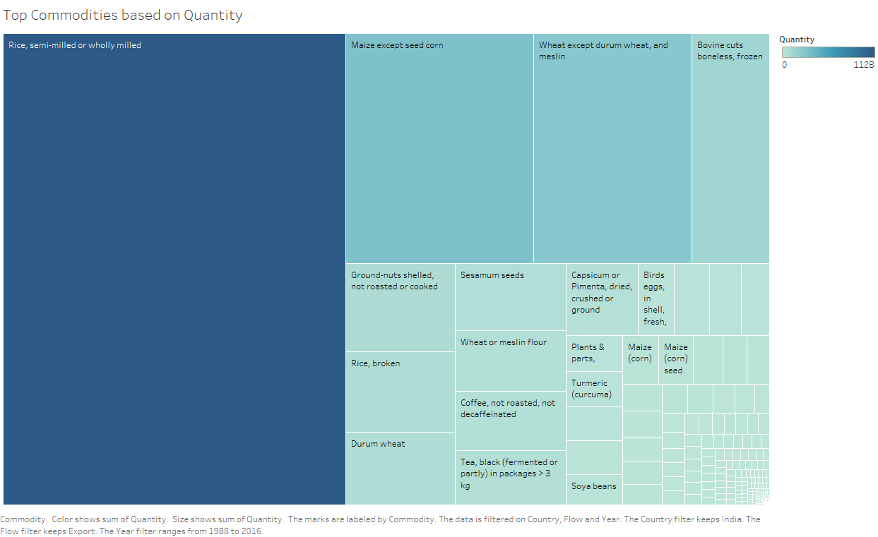
Distribution Of Commodities Based On Quantities
The heat map above shows the distribution of the number of commodities.
It can be filtered on the country, flow, and year.
As per the values depicted in the graph above, India has the highest exports of rice, semi milled or wholly milled. Mushroom spawn is not exported from India. Hence it has the quantity as zero.

Slide 17
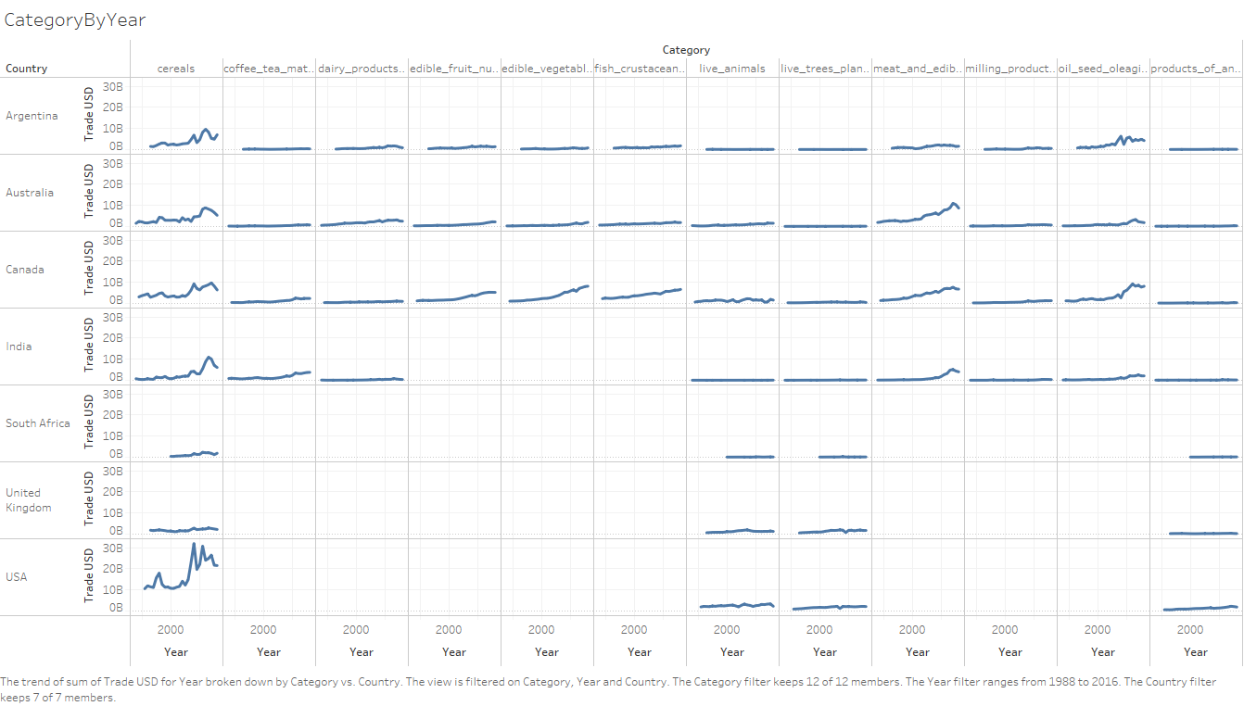
Trade Value with respect to country and categories
The above correlation chart shows the trend of Trade USD value per country and category.
The chart can be filtered based on category, year, and country.
From 1988 to 2016, the USA has been the largest exporter and importer of commodities followed by Canada at 2nd position.
After identifying the potential commodities, we can observe their quantity and unit price over the past years and it is different for each country. Further, we can use forecasting techniques to get the estimate of the unit prices for future years

Slide 18
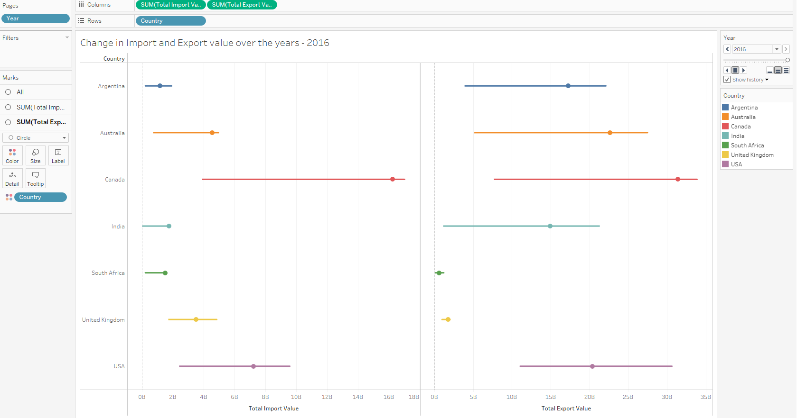
Change in Trade Value of Flow Over the Years
The above chart shows the change that has occurred in the import and export values over the years
The above chart has a live feature and hence the moving changes can be seen.
The Chart above shows the change that has occurred in the import and export values over the years. The time period can be selected as required. This chart has a live feature hence the changes can be seen as and when it happens. For eg: In the year 2016, USA has export value of $20B and import value of $7B.

Slide 19
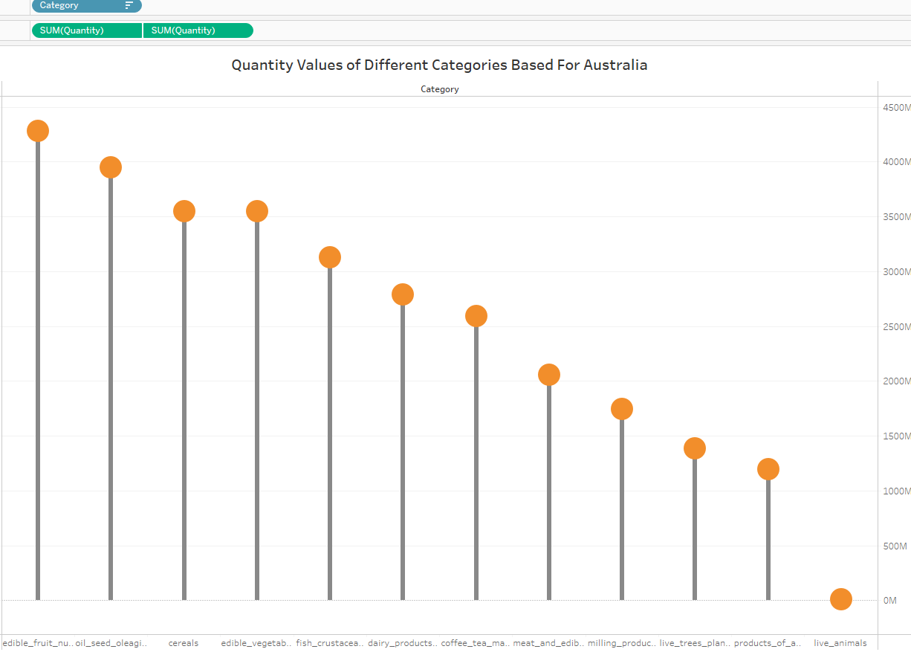
Analysis of Quantity Traded In Different Categories for Countries
The chart shows the comparison of different categories based on quantity traded in export or import
In case of Australia, Edible Fruits is the Category which is imported in large quantities whereas it’s the major exporter for Cereals.
This can be filtered for a specific country and type of flow.

Slide 20
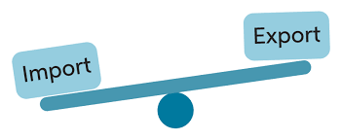

For Argentina, it’s the largest exporter for cereals whereas it imports high quantities of oil seeds
Canada imports higher quantities close to 57B edible fruits and exports cereal in high quantities
India also exports cereals in high quantities more than 185 Billion and imports cereal more compared to other categories of about 21 Billion. Its Trade balance becomes 164 billion in case of cereals
South Africa export higher quantities of cereals i.e about 28.5 Billion whereas imports 46 B of cereals . Its trade balance becomes negative i.e -17.5 B in case of cereals.
UK also is major exporter of cereals i.e 94.6 B and imports 85 B of cereals making its trade balance as approximate 9 B
USA is the largest exporter for cereals with value close to 2200 Billion and import close to 870 B of cereals

Slide 21
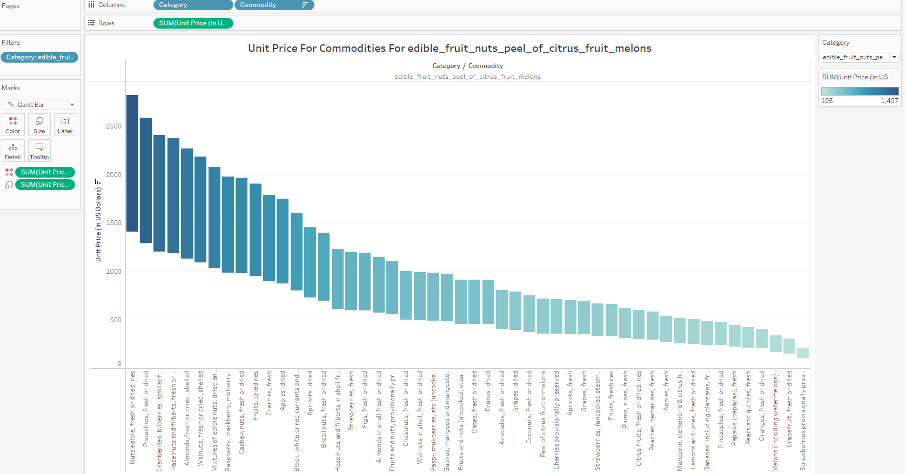
Category Wise Price Analysis for Different Commodities
The waterfall chart shows the unit price for commodities with respect to different countries
The values are sorted in descending order of prices.

Slide 22



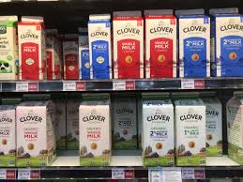
In case of cereals maize has the highest unit price whereas canary seeds has the lowest
For category of coffee tea and spices saffron has the highest unit price whereas coffee husks are the lowest
In case of dairy products bird eggs had the highest unit price , whereas egg yolks and milk were the lowest
In edible vegetables category mushroom had the highest unit price followed by potatoes
In fruits and nuts categories, edible nuts have the highest unit price followed by Pistachios and Cranberries whereas Strawberries have the lowest unit price
For trees, fruit trees is the commodity having highest unit price followed by roses whereas mushroom the lowest

Slide 23
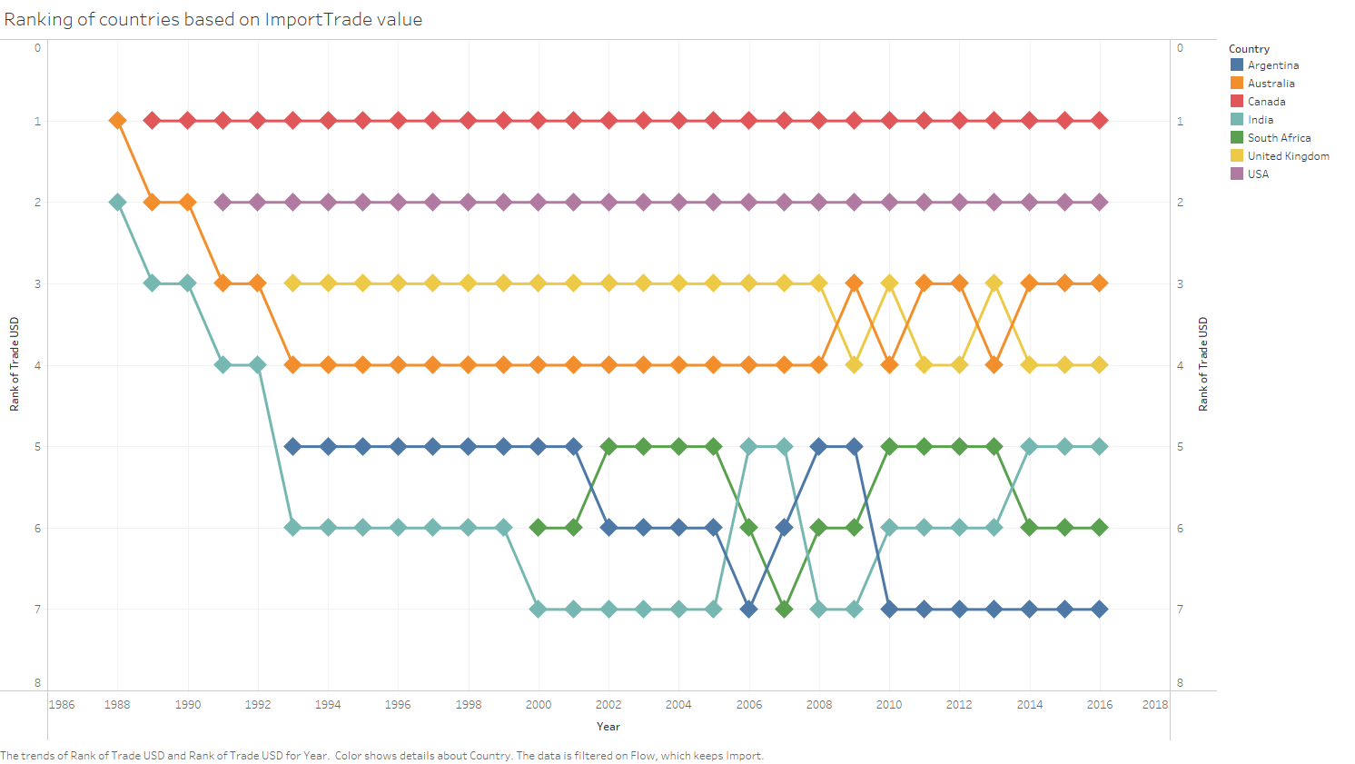
Ranking Of Different Countries Based On Trade Flow
The bump chart shows the ranking of different countries based on the import and export trade value.
It help us to compare different countries based on Trade Value

Slide 24

Export:-
In the year 1988, Australia has the highest value for trade
In the year 1989 and 1990 Canada became the lead
For the next consecutive 5 years USA was the highest exporter whereas in the 20th century for next decade Canada had been dominant
South Africa has been at the lowest level in terms of trade value
Import:-
Australia was initially the highest importer of goods then Canada became dominant. USA has the second place
India was the lowest importer beginning year 2000, then from 2010 Argentina had the lowest trade import value

Slide 25
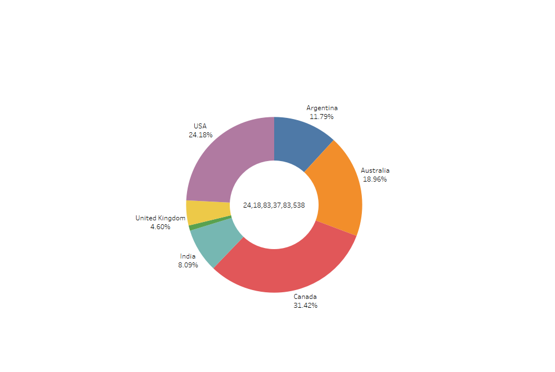
Country Wise distribution Of Global Trade Value
The above chart shows the percentage distribution of trade value for different countries.
Sum of total trade value is represented at the Center.
Canada has the highest share in trade value i.e 31.42 %
Lowest Nation being South Africa only 0.96% of the total

Slide 26
Summary Of Insights Derived
From 1988 to 2016, the USA has been the largest exporter and importer of quantity of commodities followed by Canada at 2nd position.
Canada has the largest share of Trade value whereas South Africa is the lowest
Top categories were identified for each country. Cereals being the top most category in Trade
Top commodities were identified based on their quantity traded via export and import.
After identifying the potential commodities, we can observe their quantity and unit price over the past years and it is different for each country. Further, we can use forecasting techniques to get the estimate of the unit prices for future years.

Slide 27
Thank You

